Slide 1
Rotation Curve of Milky Way
Zachary Cohen, Dechong Wang, John Wright

Slide 2
CONTENTS
Motivations
Methods
Results
Conclusions
References

Slide 3
01
Motivations

Slide 4
Motivations
Estimate galactic mass distribution
Understand relationship between mass distribution and rotation curve
Understand the components of a galaxy

Slide 5
02
Methods

Slide 6
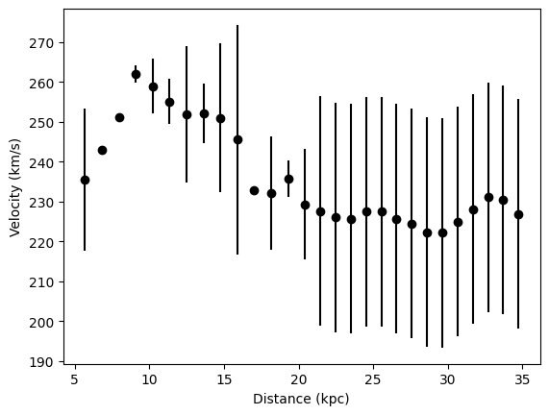
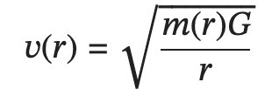

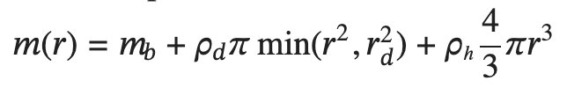
Methods
Given: rotation curve of galaxy [1]
Want to infer mass distribution
Model: velocity is afunction of enclosed mass, which is a function of radius
How does velocity depend on mass?
How does mass depend on radius?
Three components:
Galactic bulge (always enclosed, constant)
Galactic disc (thin cylinder, so increases quadratically up to disc radius)
Galactic halo (sphere, increases cubically)

Slide 7
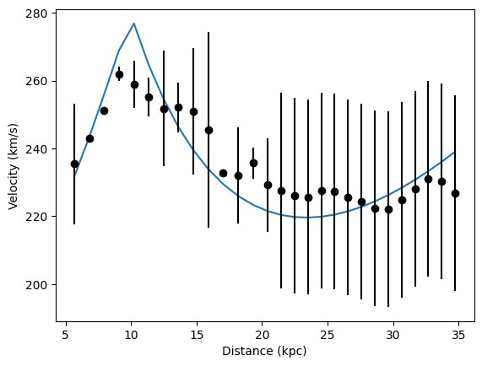
Estimation: if we rewrite theprevious equations, we get
And we can apply standard linear regression to get easy mass estimates

Slide 8
03
Results

Slide 9
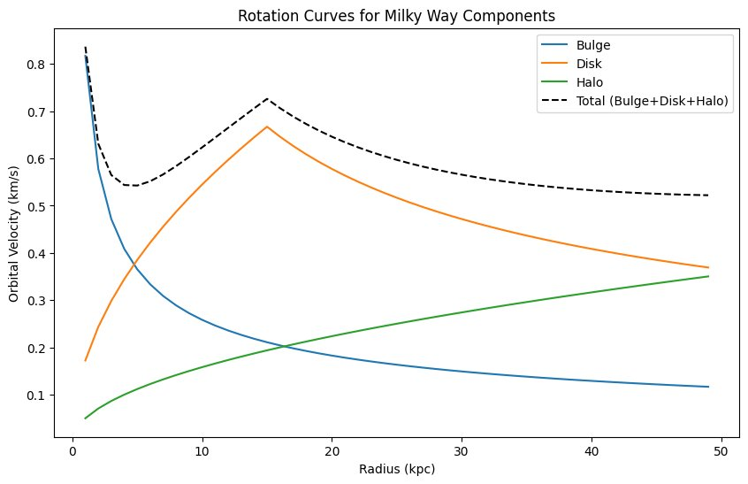
Results
What does this model produce?
Comparison with observations
Mass estimates
Bulge, disc, halo

Slide 10
Comparison with observations

Slide 11
04
Conclusions

Slide 12

Simple model of mass distribution works reasonably well
Mass is distributed along the components of the Milky Way, but there is still unexplained mass present

Slide 13
05
References

Slide 14

References
[1] Carignan, Claude, et al. "The extended HI rotation curve and mass distribution of M31." The Astrophysical Journal 641.2 (2006): L109.

Slide 15
THE END
THANKS

